Slide 1







PENINGKATAN SISTEM DOKUMENTASI PERMINTAAN LAYANAN IT DENGAN PEMBUATAN FORMULIR DIGITAL MENGGUNAKAN COGNITO DI ITKI RSUD DR. SOETOMO PROV. JATIM
Disusun oleh
Ogy Rachmad Iriansah
199408262022041001
mulai

Slide 2








sdsadsad
Alur Kegiatan
x
x
x
1 sept - 2 Sept
5 Sept- 7 Sept
8 Sept- 9 Sept
Open
Open
Open

Slide 3



sdsadsad
Alur Kegiatan
x
x
x
12 sept - 14 Sept
15 Sept- 16 Sept
23 Sept
Open
Open
Open

Slide 4



sdsadsad
Alur Kegiatan
x
x
x
15 Sept- 16 Sept
23 Sept
23 Sept
x
Open
Open
Open
12 sept - 14 Sept
Open

Slide 5
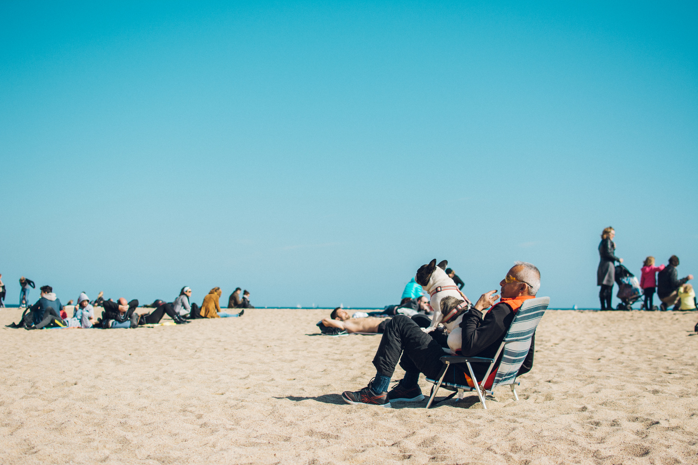
The Picture of the Perfect Retirement
1
Travel and see the world.
2
Be happy and comfortable every day.
3
Have a sense of purpose and meaning.
4
Volunteer and feel wonderful helping other people.
5
Live independently with love and purpose.

Slide 6

Retirement Planning Checklist
Age today: 28 years old | Age at retirement: 60 years old | Years to retirement: 32 years
 | Task | Notes
 | Started a savings account for retirement | Double click to add notes
 | Downsized debt
 | Calculated income needed for retirement expenses
 | Budgeted cost of medical care upon retirement
 | Attended a Retirement 101 webinar
 | Acquired an investment plan purely for growing retirement money

Slide 7


Retirement Income Sources
 | Monthly | Quarterly | Annual
Social Security Income | $500 |  | $6,000
Company Pension | $1,000 |  | $12,000
Investment Income |  | $2,000 | $8,000
Other Income | $1,000 |  | $12,000
Total | $38,000

Slide 8

Basic Monthly Requirements
 | Current | Estimated Cost Upon Retirement
Housing or Rent | $850 | $1,000
Transportation | $200 | $350
Electricity | $500 | $650
Water | $50 | $75
Cable TV | $50 | $75
Internet | $90 | $110
Communication | $30 | $45
Total | $,1770 | $2,305

Slide 9

 | Current | Estimated Cost Upon Retirement
Food | $850 | $1,000
Clothing | $500 | $650
Travel | $1,000 | $2,000
Entertainment | $50 | $75
Membership | $50 | $75
Shopping | $850 | $1,000
Total | $3,300 | $4,800
Personal Monthly Expenses

Slide 10
6 Agst - 7 Sept
1 Agst - 5 Sept
sdsadsad
Alur Kegiatan
x
x
x
1 Agst - 5 Sept
6 Sept- 7 Sept
8 Sept- 9 Sept
Open
Open
Open

Slide 11
Alur Kegiatan

Slide 12
Alur Kegiatan

Slide 13

Notes and Reminders
Add notes and reminders here. Press "T" to add a new one!

Slide 14






















Resource
Page
Use these design resources in your Canva Presentation. Happy designing!
Don't forget to delete this page
before presenting.

Slide 15










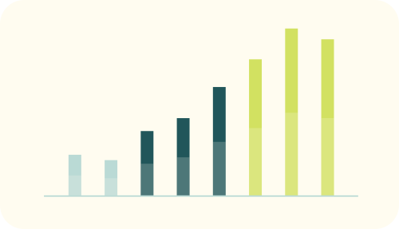




Resource
Page
Use these design resources in your Canva Presentation. Happy designing!
Don't forget to delete this page
before presenting.

Slide 16






















Resource
Page
Use these design resources in your Canva Presentation. Happy designing!
Don't forget to delete this page
before presenting.

